Slide 1

EXCEPTIONAL SURVIVAL MODEL MINING
Juliana B. Mattos¹, Eraylson G. Silva¹, Paulo S. G. de Mattos Neto¹, and Renato Vimieiro²
¹ Centro de Informática, Universidade Federal de Pernambuco, Recife-PE, Brasil {jbm4,egs,psgmn}@cin.ufpe.br
² Universidade Federal de Minas Gerais, Belo Horizonte-MG, Brasil rvimieiro@dcc.ufmg.br
Notes:
Hello!
My name is Juliana, and I’m here to present the paper:
Exceptional Survival Model Mining

Slide 2







Context & Problem
WHO ARE SUCH SUBGROUPS?
WHICH CHARACTERISTICS DELINEATE GROUPS OF PATIENTS WITH DISTINCT SURVIVAL EXPERIENCE?
WHICH FACTORS ARE ASSOCIATED WITH DIFFERENT PROGNOSTICS?
Image source: https://blog.crownbio.com/pdx-personalized-medicine#_(access: September 11th, 2020)
Large-scale biologic databases
Methods for characterizing patients
Strong computational tools
Notes:
For many years now,
the medical interventions are based on standard treatments
prescribed to a large group of patients under a same general medical condition
For example: “breast cancer”, “diabetes”, “Alzheimer's”, …
Usually,
from this large group of patients
some will improve,
some will have no change in their medical conditions,
and a few will have adverse effects.
However,
The recent development of:
biologic databases
And of methods for characterizing patients: such as genomics and diverse cellular assays
combined with computational tools for analysing large sets of data
are conducting medicine towards a new approach that takes individual variability into account
This emergent approach is based on the idea of personalised medical treatments
to be prescribed to smaller and more specific groups.
Such personalised interventions can better address the needs of a patient as an individual,
providing better treatment responses
and improving the patients’ prognosis and survival outcomes.
The problem is: WHO ARE SUCH SUBGROUPS?
Which characteristics define groups with different survival experience?
And by “characteristics” we mean all available information on the patient:
such as molecular, genomic, clinical, behavioural, physiological, and even environmental aspects.
And thus
Which of these factors are associated with different prognostics?

Slide 3
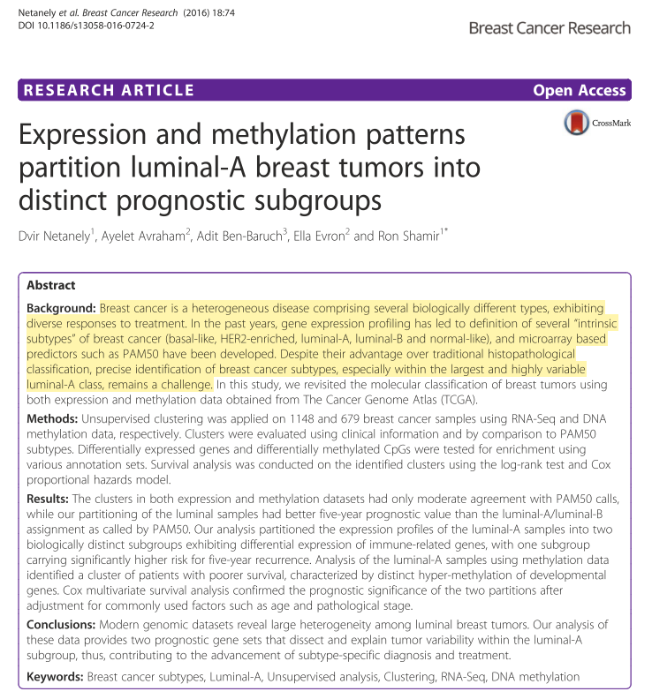

The Problem in the Literature
Shivakumar, M., Lee, Y., Bang, L., Garg, T., Sohn, K.A. and Kim, D., 2017. Identification of epigenetic interactions between miRNA and DNA methylation associated with gene expression as potential prognostic markers in bladder cancer. BMC medical genomics, 10(1), p.30.
Breast cancer is a heterogeneous disease comprising several biologically different types, […]
precise identification of breast cancer subtypes, especially within the largest and highly variable luminal-A class, remains a challenge.
Pepke, S. and Ver Steeg, G., 2017. Comprehensive discovery of subsample gene expression components by information explanation: therapeutic implications in cancer. BMC medical genomics, 10(1), pp.1-18.
Basal-like constitutes an important molecular subtype of breast cancer characterised by an aggressive behaviour and a limited therapy response.
The outcome of patients within this subtype is, however, divergent. Some individuals show an increased risk of dying in the first five years, and others a long-term survival of over ten years after the diagnosis.
Smith, M.K., Stein, G., Cheng, W., Miller, W.C. and Tucker, J.D., 2019. Identifying high risk subgroups of MSM: a latent class analysis using two samples. BMC infectious diseases, 19(1), p.213.
Netanely, D., Avraham, A., Ben-Baruch, A., Evron, E., & Shamir, R. (2016). Expression and methylation patterns partition luminal-a breast tumors into distinct prognostic subgroups. Breast Cancer Research, 18(1):74.
Lu, T.P. and Chen, J.J., 2015. Subgroup identification for treatment selection in biomarker adaptive design. BMC medical research methodology, 15(1), p.105
Milioli, H. H., Tishchenko, I., Riveros, C., Berretta, R., & Moscato, P. (2017). Basal-like breast cancer: molecular profiles, clinical features and survival outcomes. BMC medical genomics, 10(1):19.
Notes:
A variety of medical researches strive to identify factors associated to the survival response of patients.
The article in the left call attention to the fact that
The breast cancer comprises several subtypes
whose precise identification
is still a challenge.
The article here on the right pinpoint that
Evidences suggest the existence ofat least two clinically and undefined different groups under Basal breast cancer,
with poor or excellent survival.
When looking into the literature,
many studies reveal the limitations of the current diseases’ markers
reinforcing the need for a better characterisation of diagnostic and prognostic groups.
Hence,
a large number of studies strive to better understand
the hidden patterns that affect survival.

Slide 4







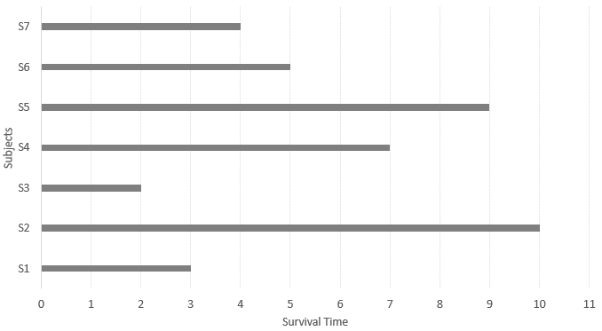




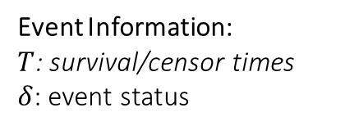
Survival Analysis
Collection of methods and techniques designed to analyse data in which the target variable is the time until a given event occurs.
Survival Time
Observed times:
event
censor
SURVIVAL MODEL
Begin of study
Event
?
GOAL
To estimate the time to the event for a new instance, based on feature predictors.
SURVIVAL DATA:
?
Set of descriptive attributes
?
Event Information:
$T$: survival/censor times
$δ$: event status
End of study
Notes:
For this end, most studies resort to the Survival Analysis
That is the collection of methods that analyse data in which the target variable is the time until some event occurs.
For event,
we can understand any experience of interest: death, disease recurrence, rehospitalization, etc
We call survival time the time between the begin of the study
and the event occurrence.
The goal of Survival Analysis is to estimate the time to the event for a new instance
The main characteristic of the survival data
is the existence of observations for which
we don’t know the time of the event
This phenomenon is called censoring.
and The Survival Analysis methods strive to incorporate
the partial information provided by the censoring
in the estimation of the survival time.

Slide 5

Survival Analysis Methods
STATISTICAL METHODS
MACHINE LEARNING METHODS
RULE-BASED METHODS
Non-Parametric
Semi-Parametric
Parametric
Survival trees
Bayesian methods
Neural Network
Support Vector Machine
Ensemble
Active/Transfer/Multi-task learning
Rough sets
Bump hunting
Logical Analysis of Data (LAD)
Survival tree
Sequential covering
….
distributional and restrictive assumptions
distributional and restrictive assumptions
Simple and understandable results
modelling non-linear relationships
high quality results
Notes:
The main existent methods can be divided into 3 categories:
The traditional Statistical Methods suffer from the limitations of distributional assumptions
that not always can be satisfied.
The machine learning methods overcome those limitations
with the advantage of modelling non-linear relationships
and delivering high quality results.
However, such models are usually hard to understand.
when compared to the machine learn methods,
Rule-based approaches deliver results that are easier to explain
and to understand.

Slide 6

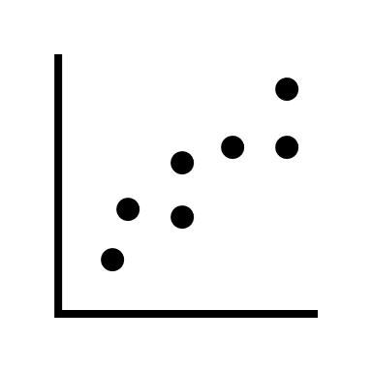

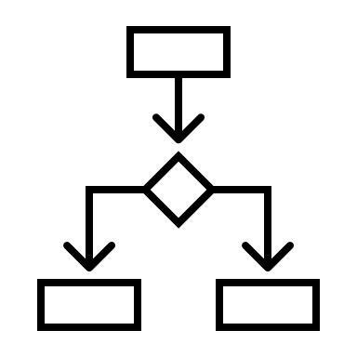

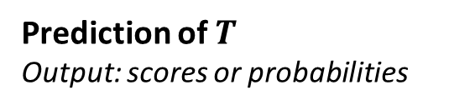
Survival Analysis Methods
STATISTICAL METHODS
GLOBAL MODELS
MACHINE LEARNING METHODS
Prediction of $T$
Output: scores or probabilities
GOAL
RULE-BASED METHODS
Classification of new instances
Output: partitions of the data
PREDICTIVE APPROACHES
Discretization or stratification of the time variable
Covariates’ split criterion and stratifications
Impel observations to fit pre-defined classes
CHARACTERIZATION
Notes:
However,
it’s important to notice that all those approaches are predictive,
And comprise global models that strive to maximize the predictive power.
With the goal of either:
predict the survival time
or classify new instances
The approaches that strive to describe subgroups
with different survival behaviour usually resort:
To the discretization or stratification of features;
or even impel the observations to fit pre-defined classes

Slide 7



Research Opportunity
Characteristics for distinct survival experience?
Factors associated with different prognostics?
WHO ARE SUCH SUBGROUPS?
GLOBAL MODELS
LOCAL PATTERNS
EXISTENT APPROACHES
previously known variable’s interactions
lack the ability to shed light into new interactions
GOAL
Discover and describe
multiple (and potentially overlapping) interesting subgroups with relation to the survival response
Notes:
But when we go back to our initial problem
of identifying factors associated to survival response:
These existent approaches rely on features’ interactions that are already known,
lacking the ability of provide new
and possibly unknown interactions.
In contrast to the predictive approaches,
A new look at this problem may comprehend the data as
a potential composition
of different subsets
that present distinct survival behaviour
and, thus,
strive to uncover local patterns associated to survival response.
Therefore,
Our goal is:
To Discover and describe
multiple
and potentially overlapping
interesting subgroups with relation to the survival response.

Slide 8





Exceptional Model Mining (EMM)
DATA MINING PERPECTIVES
Descriptive
Predictive
EXCEPTIONAL MODEL MINING
Property of interest:
single attribute
SUBGROUP DISCOVERY
SUPERVISED DESCRIPTIVE PATTERN MINING
Understand the underlying phenomena – according to a property of interest (target).
Property of interest:
model
Heuristic Search Strategies
PROBLEM STATEMENT
Beam search
The task of EMM is:
To discover the subgroups of the population that are statistically "most interesting“, i.e. are as large as possible and have the most unusual statistical characteristics with respect to the model of interest.
Evolutionary Computing
No EMM works exploring bio-inspired meta-heuristic
Notes:
For that goal,
we propose the use of Exceptional Model Mining.
We call
Supervised Descriptive Pattern Mining
the tasks that lie in intersection of both predictive and descriptive data mining perspectives
providing descriptive knowledge from labeled data.
The Exceptional Model Mining task
understands the target - or property of interest
as a model of any kind
Therefore:
Given:
a population of individuals
a model of those individuals that we are interested in
The task of Exceptional Model Mining is:
To discover the subgroups of the population that are
as large as possible
And for which the model fitted to the subgroup is statistically different from the same model fitted to the whole data
Or to the subgroup’s complement
It can be understood as a generalization of Subgroup Discovery
That is the especial case where the model is reduced to a single attribute.
Because of the combinatorial nature of pattern mining process
The search strategy is a challenge for the algorithmic approaches,
And essential for good performance
The existing heuristic approaches on both these tasks mainly explore the use of:
the greedy heuristic Beam Search
and of Evolutionary Computing
The evolutionary algorithms have been widely studied
specially for Subgroup Discovery
And present great results regarding both
computational aspects
and quality of the patterns
However, to the best of our knowledge,
there is no work on Exceptional Model Mining
that explores the application of bio-inspired meta-heuristics as search strategy.

Slide 9
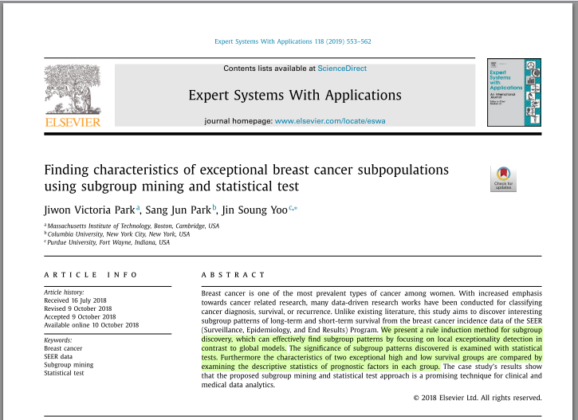
EMM & Survival Analysis
INTERESTING LOCAL PATTERNS
Park, J.V., Park, S.J., Yoo, J.S.: Finding characteristics of exceptional breast cancer subpopulations using subgroup mining and statistical test. Expert Systems with Applications 118, 553–562 (2019)
No works striving to uncover subgroups with unusual survival models
SUBGROUP DISCOVERY FRAMEWORK
Tree-based rule induction approach
Target: mean survival time
Notes:
When addressing the problem of characterizing groups of patients
through the perspective of local patterns,
to the best of our knowledge,
there is only one Subgroup Discovery approach
to analyse survival in breast cancer.
that uses mean survival time as the target variable,
To the extent of our knowledge,
there is no work that explores the use of the Exceptional Model Mining
to provide comprehensible identification of subgroups with unusual survival behaviour.

Slide 10
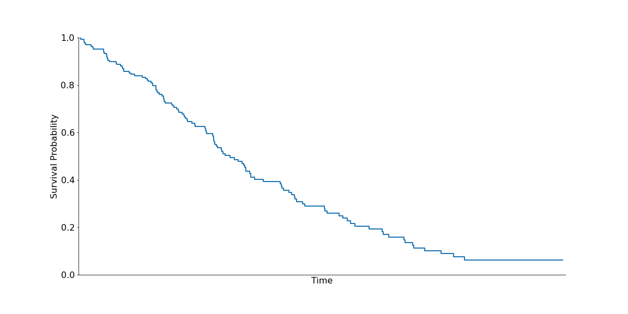
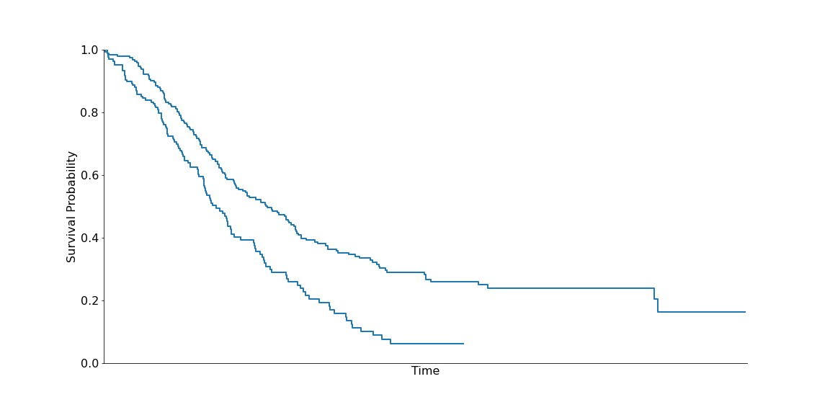
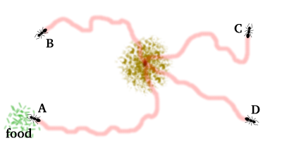
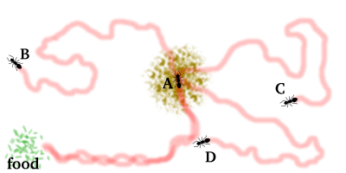
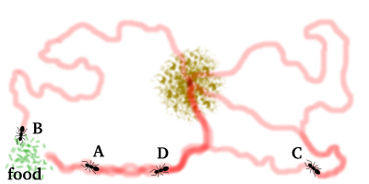
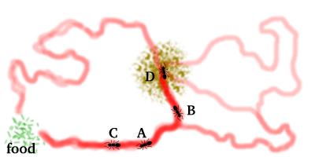
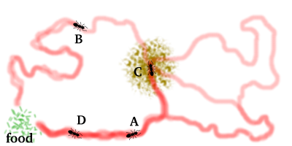
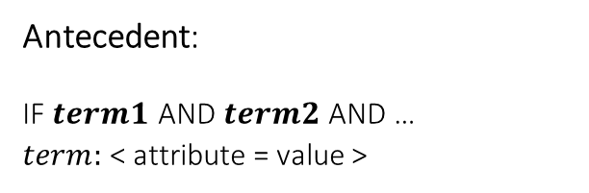
Exceptional Survival Model Ant Miner – ESM-AM
EMM FRAMEWORK:
Search for subgroups with exceptional survival functions
Output: SET OF RULES
Model:
IF <conditions> THEN <KM model>
KAPLAN MEIER (KM) ESTIMATES
Antecedent:
IF $term1$ AND $term2$ AND …
$term:$ < attribute = value >
Consequent
Interestingness measure:
LOGRANK STATISTICAL TEST
Search strategy:
EXCEPTIONAL SUBGROUP
CHARACTERISATION
SUBGROUP’S SURVIVAL MODEL
ANT-COLONY OPTIMIZATION
Notes:
Finally,
We present the Exceptional Survival Model Ant Miner algorithm
That is an Exceptional Model Mining framework
designed for discovering subgroups with exceptional survival functions.
For the class model,
we use the Kapplan Meier estimates – or survival curves,
That is a non-parametric statistical method of Survival Analysis
And indicates the probability that an individual survives up to a specified future time.
For measuring how interesting a subgroup is,
we use the Logrank statistical test,
that is a chi-squared test
With the null hypothesis that there is no difference between survival curves.
For the search strategy
Instead of employing beam search,
our algorithm employs the Ant-Colony Optimisation meta-heuristic
That is based on the behavior of some ant species
that use a pheromone trail as an indirect form of communication.
The algorithm returns a set of rules
Where each rule describes an exceptional subgroup.
The rules follow this form,
where the antecedent is a conjunction of terms
In the form of attribute equal value
because this version of the algorithm only copes with categorical features.
The consequent of the rule
is the survival model fitted for the cases that satisfy the antecedent.
Therefore, the antecedent of a rule provides a subgroup’s description,
and the consequent provides its exceptional model.

Slide 11
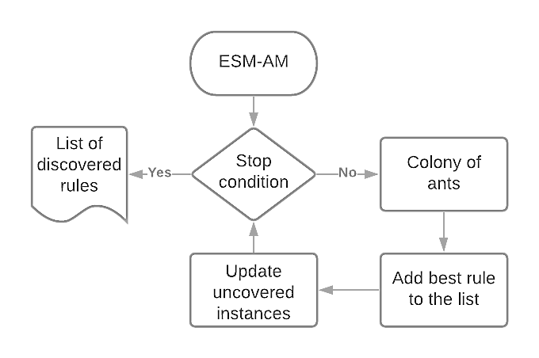


Exceptional Survival Model Ant Miner – ESM-AM
Stop condition:
Adaptation of the Ant-Miner algorithm
to discover subgroups with exceptional survival functions
Uncovered cases
Number of iterations
Parpinelli, R.S., Lopes, H.S., Freitas, A.A.: Data mining with an ant colony optimization algorithm. IEEE Transactions on Evolutionary Computation 6(4), 321–332 (2002)
1
Exceptionality:
Subgroup versus Complement
3
2
Stop condition:
Rule convergence
Non-significant rules are discarded at a level of significance of α
COVERING-BASED APPROACH
Entire colony
User-defined parameters:
no_of_ants
max_uncovered_cases
no_rules_converg
min_cases_per_rule
α
1
If no significant rules are discovered, the algorithm is finalized
3
2
Notes:
Our algorithm is an adaptation Ant-Miner algorithm.
And has five user-defined parameters
It follows a covering-based approach,
where
A colony of ants constructs a number of rules;
the best rule – according to a quality measure based on the logrank’s p-value – is added to the list of discovered rules;
and the cases covered by the best rule are removed from the uncovered cases counting.
This process is repeated while:
- the number of remaining uncovered cases do not achieve a maximum threshold
- or until a maximum number of iterations is reached.
The colony of ants constructs the solutions in 3 steps:
The Rule construction,
follows a general-to-specific approach
The rule pruning
That aims at maximizing the rule’s quality.
And the pheromone updating,
That updates the amount of pheromone associated to the terms
This process is repeated until:
- all ants in the colony have constructed their rules,
- or until the ants converge to a single rule
Some highlights are that
>> The survival model of the subgroups is deemed exceptional in comparison to the model of the subgroup’s complement.
>> The Non-significant rules are discarded at a level of α
>> and IF no significant rules are discovered after an entire colony, the algorithm is finalized

Slide 12
ESM-AM Results
#rules & rule length
Rule coverage
14 real-world survival data sets
Compact models
Neither cover most cases nor very small groups
Removal of observations containing missing values
Feature selection
Discretization with K-Means into five interval categories
IBS
Ruleset coverage
Homogeneous subgroups
Variability
Rule-models’ evaluation metrics
Number of rules
Rule length
Discovery of exceptional survival behaviour
Rule coverage
Discovery of significant subgroups and identification of data characteristics that interfere in survival experience
Ruleset coverage
Integrated Brier Score (IBS)
Notes:
The performance of the algorithm was evaluated on 14 data sets
The preprocessing step included
The removal missing values
feature selection.
And discretization with K-Means
We evaluated the sets of discovered rules,
according to this 5 characteristics
[rule-models results]
[#rules/length] We notice that the algorithm was able of generating compact models concerning both the size of the ruleset and the length of the rules.
[ruleCov] The rules neither cover the majority of the cases nor very small groups.
[setCov] for the coverage of the final rule models, the results presented some variability
[IBS] and for the IBS
we notice that the algorithm was able to discover homogeneous subgroups concerning the survival response.
[subgroup discovery]
We also notice that the algorithm was able to discover significant subgroups
and to identify data characteristics that interfere in survival experience.

Slide 13
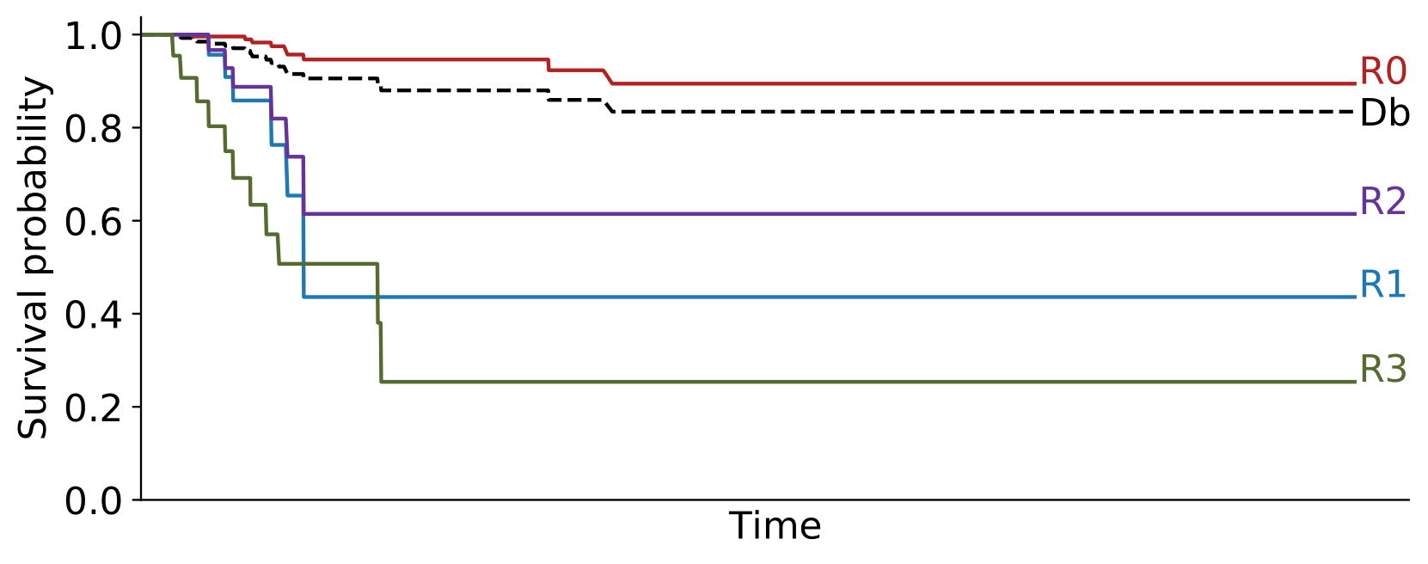
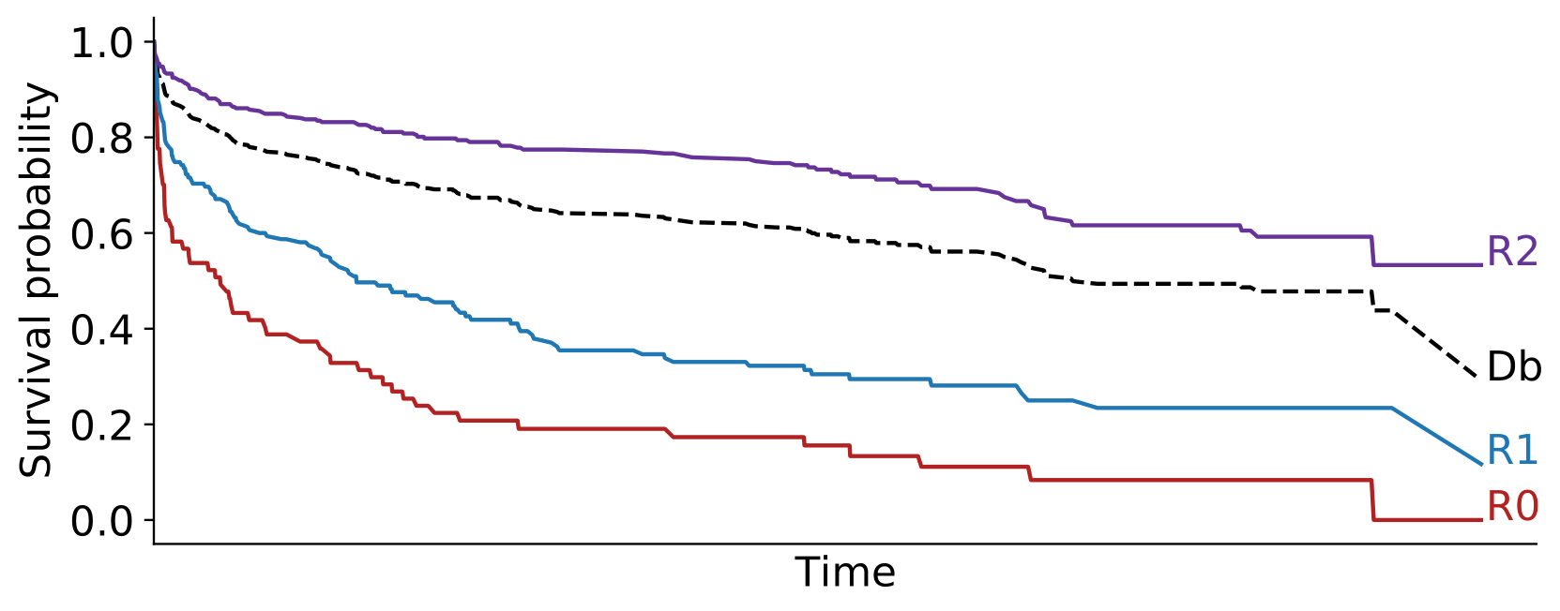
ESM-AM Results
PTC: Papillary thyroid carcinoma
Whas500: Worcester Heart Attack
Event: recurrence/progression
Event: death
Local patterns with significant distinct survival response
Notes:
These 2 figures present the survival curves
for the models induced
on these two data sets
The plots additionally include the survival curve of the entire data set
given by the hashed line
We can observe
the significant difference between the population’s survival response
in comparison to the subgroups curves
Indicating that the algorithm is able to identify local patterns
with unusual survival responses
In a more detailed analysis,
we show that the algorithm also retrieved information
on attributes
that stratify the data
into different survival experiences

Slide 14
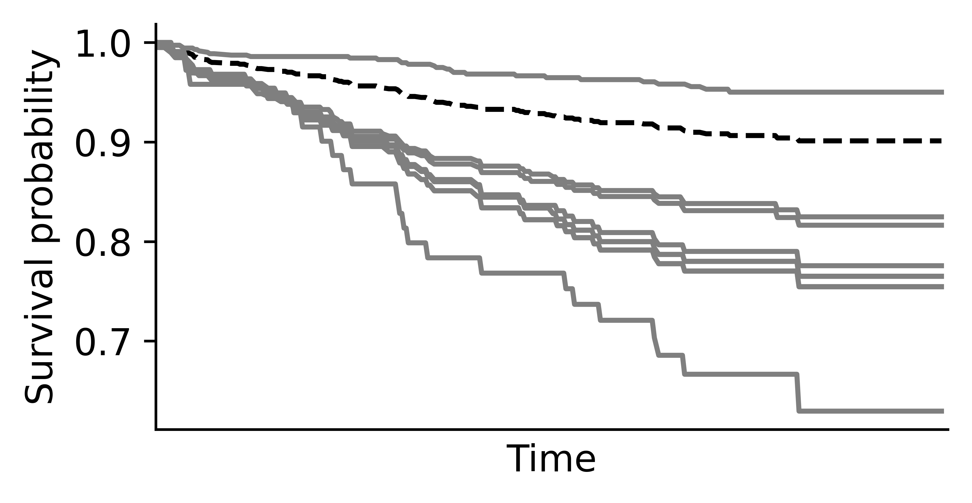
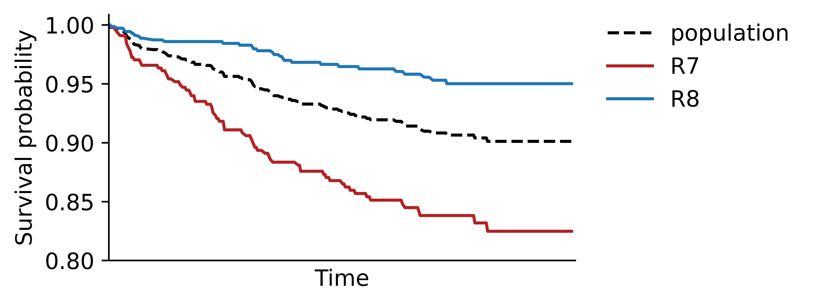
ESM-AM Results
Discovered sugbroups for actg320 dataset
R7: IF strat2 = 0 THEN average survival = 226.94
R8: IF strat2 = 1 THEN average survival = 232.19
ACTG320 DATA SET
HIV infected patients
Strat2 = {0,1} (low/high)
counting of cells with CD4 protein expression
Notes:
In the data set of HIV infected patients:
The strat2 variable represents the counting of cells with expression of the CD4 protein
and it divides the observations into low/high counting
where a low counting: strat2 equal 0
imply a higher risk for the patient.
The algorithm recovered such information in these two rules
We also present the average survival of the subgroups as additional information.
Here, the subgroups’ survival curves
reflect the expected survival behaviour
With the low counting group presenting worse prognosis.

Slide 15
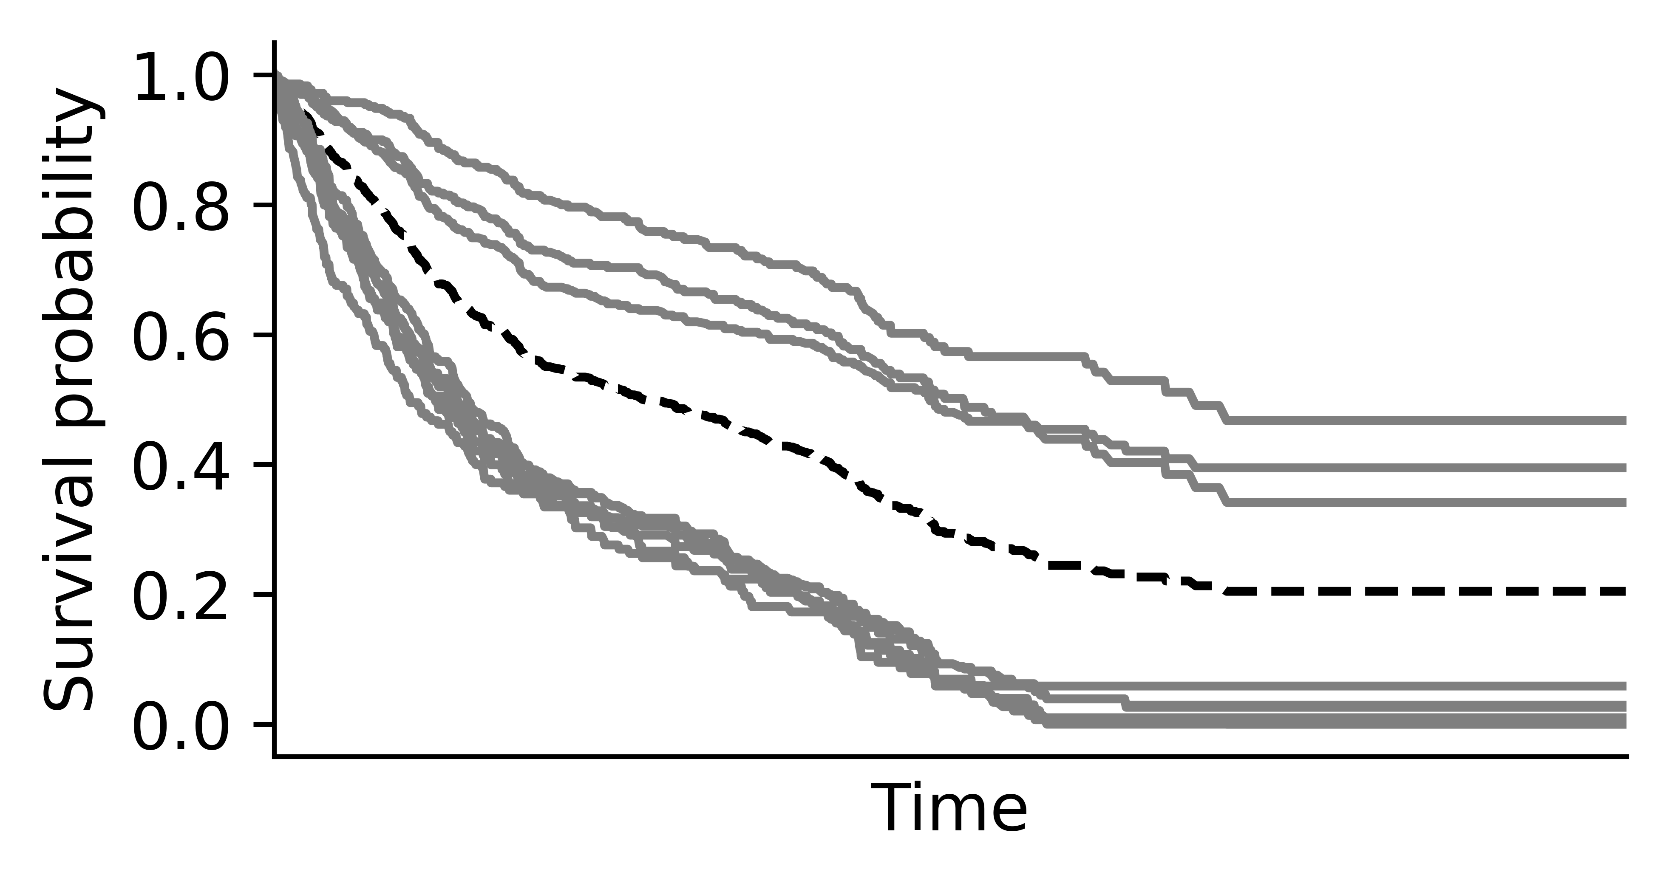
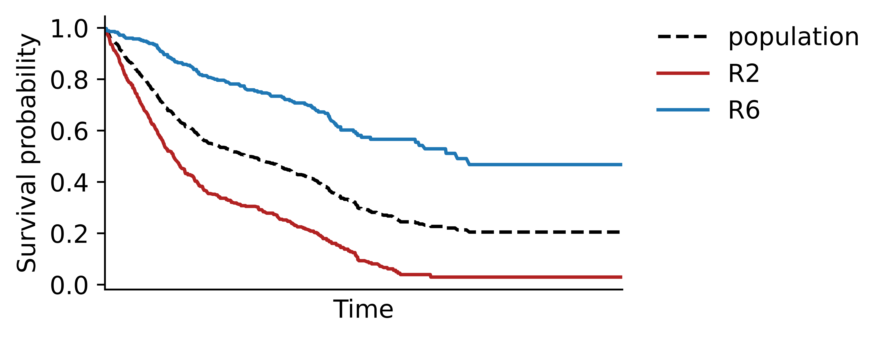
ESM-AM Results
Discovered sugbroups for lung dataset
R2: IF stage-1 = 3 THEN average survival = 835.80
R6: IF stage-1 = 1 THEN average survival = 1523.17
LUNG DATA SET
Early lung cancer
stage1 = {1,2,3} (1 < 3)
general stage of lung cancer
Notes:
In the lung data set:
the stage1 feature reflects the overall stage of lung cancer,
for stage equal 1 earlier than stage equal 3.
The algorithm was able to recover this feature
And the survival curves show that
the survivability is better for early lung cancer stage.

Slide 16
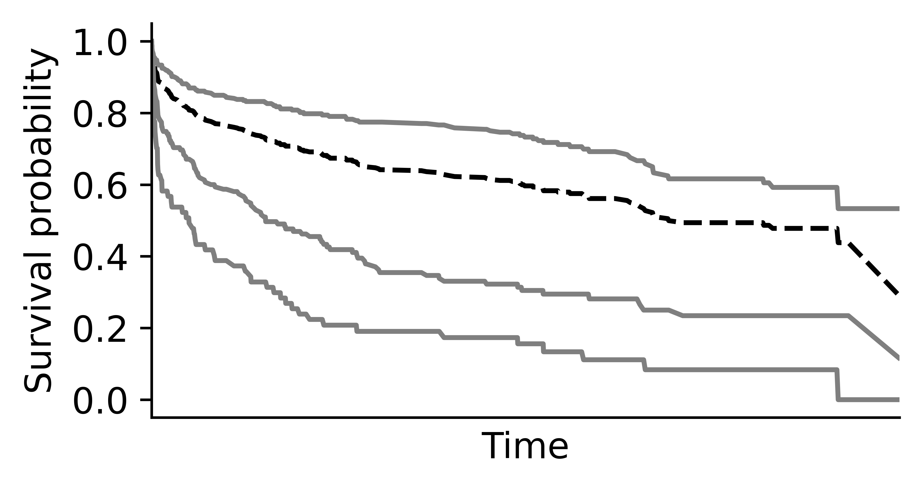
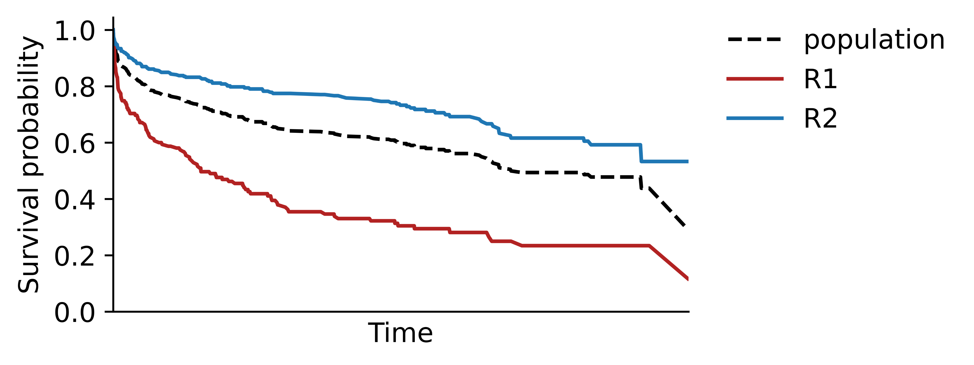
ESM-AM Results
Discovered sugbroups for whas500 dataset
R1: IF chf = True THEN average survival = 593.59
R2: IF chf = False THEN average survival = 1012.21
WHAS500 DATA SET
Worcester Heart Attack
Chf = {True, False} congestive heart complications
Notes:
In this Heart Attack data set:
the chf feature divides the observations into 2 groups of patients:
the ones that present heart complications and the ones that do not
The algorithm also captured this feature.
And the survival curves of both subgroups show that
the presence of heart complications decreases the chances of survival.

Slide 17
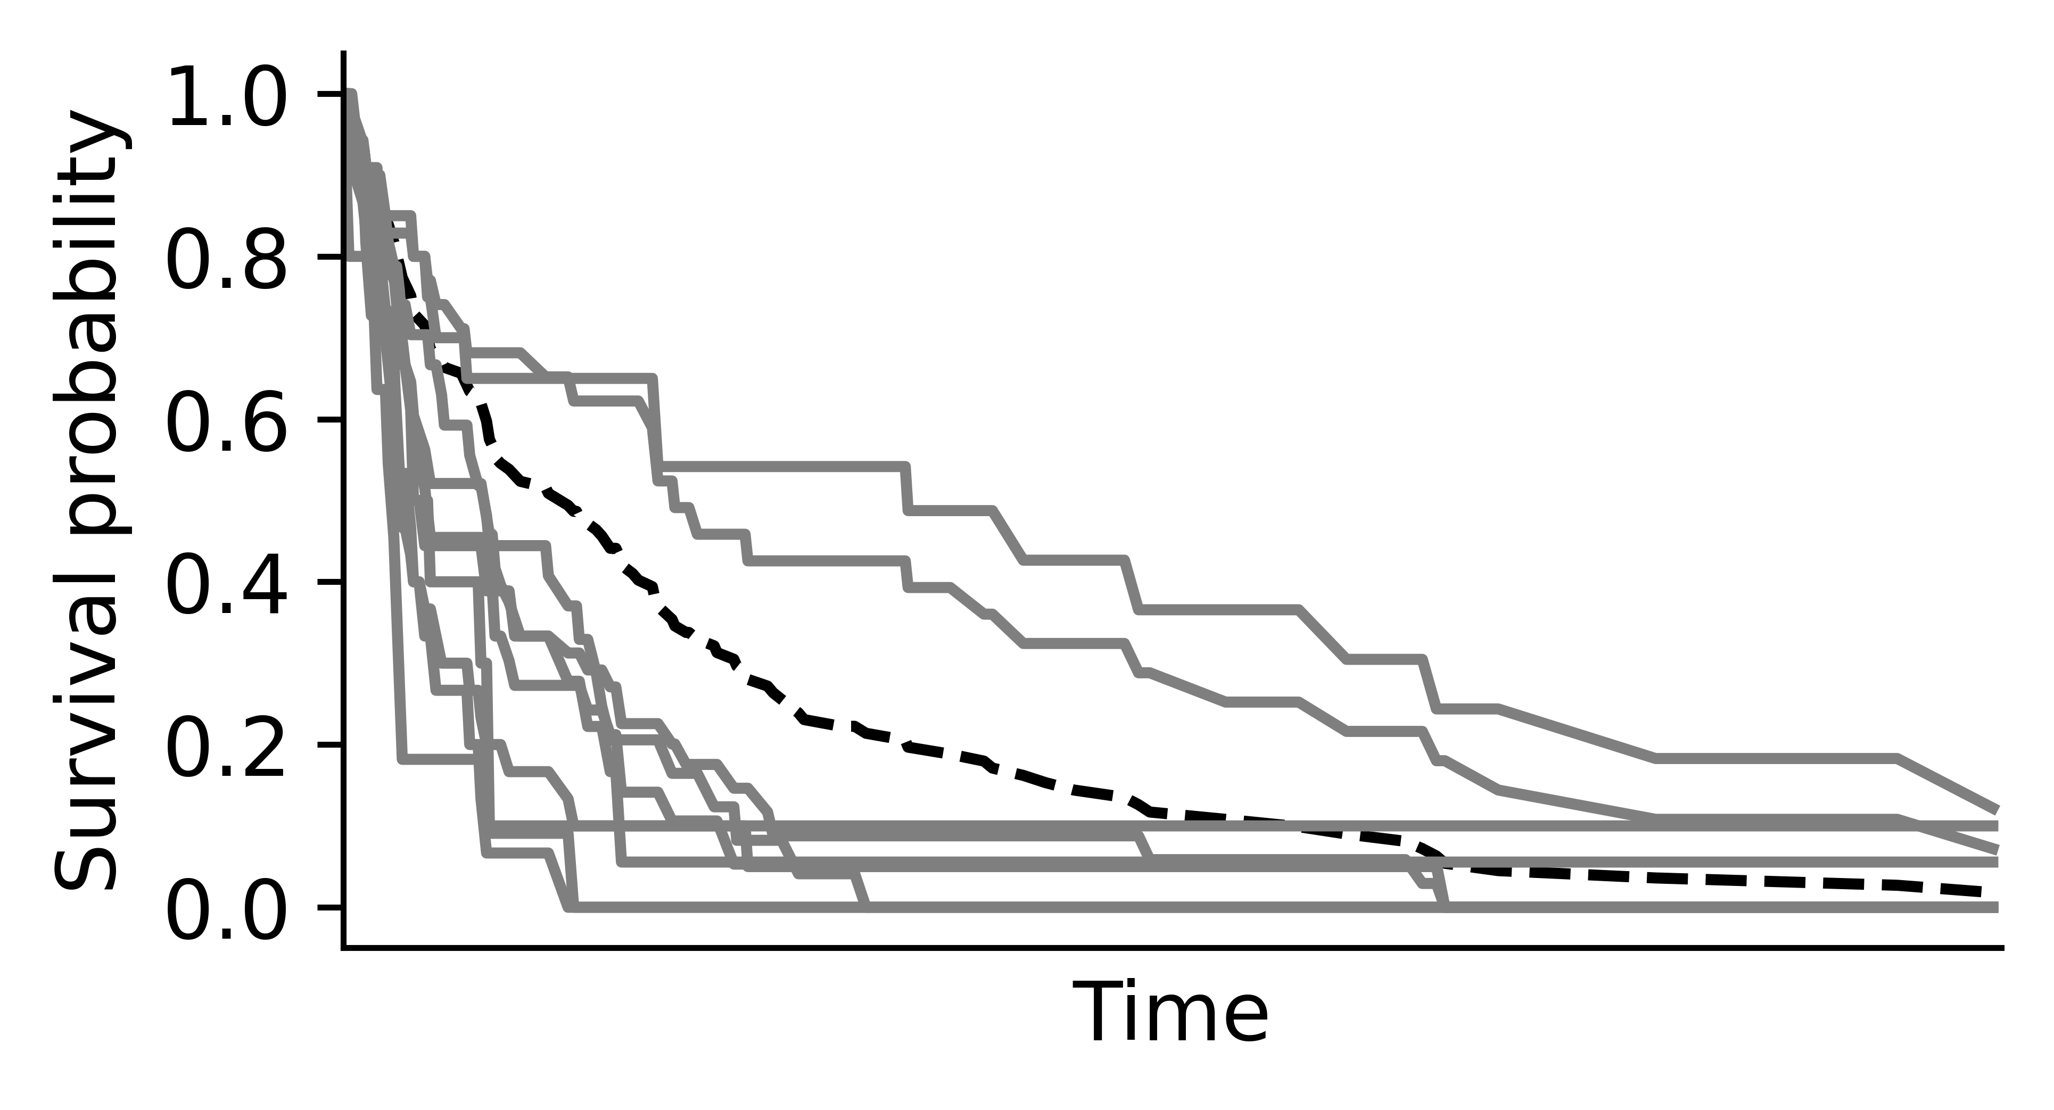
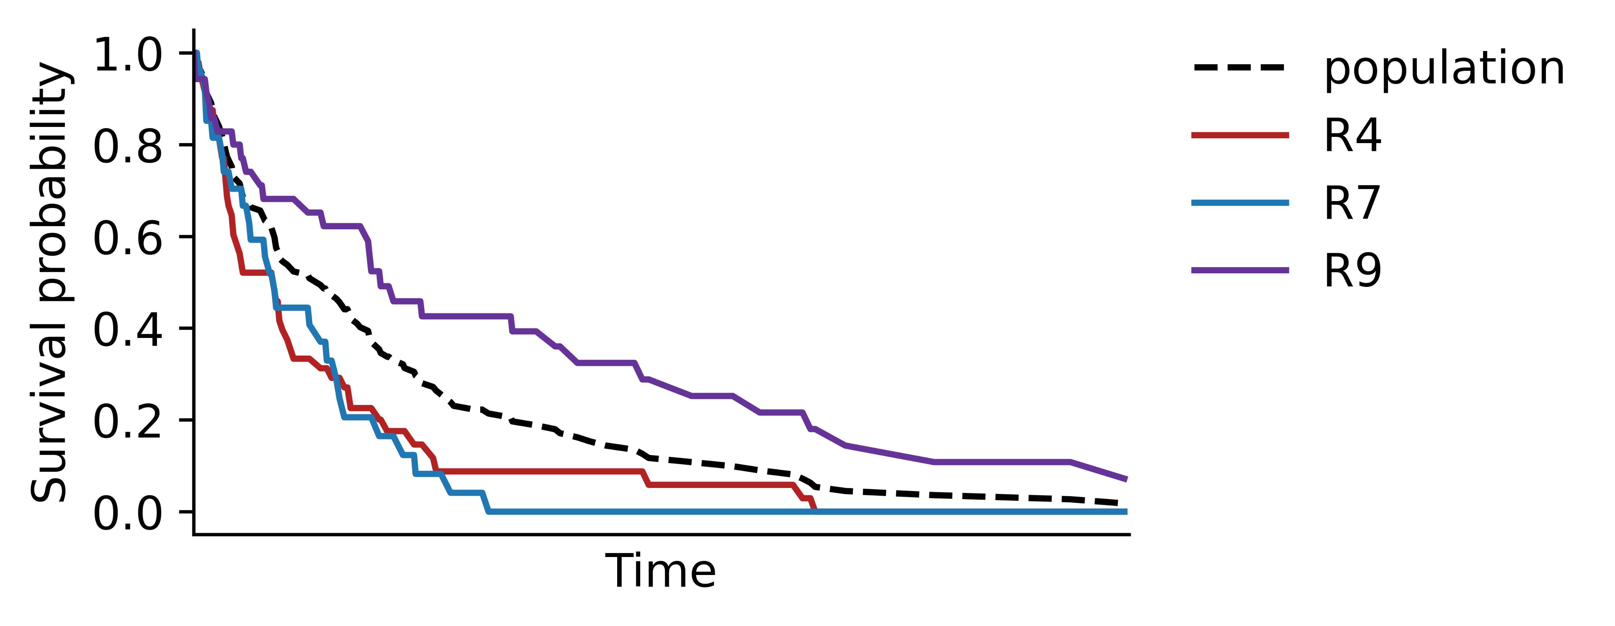
ESM-AM Results
Induced rules for veteran dataset
R4: IF cell-type = small THEN average survival = 71.67
R7: IF cell-type = adeno THEN average survival = 64.11
R9: IF cell-type = aquamous THEN average survival = 200.20
VETERAN DATA SET
Lung cancer
Cell-type:
small, adeno, aquamous
Notes:
In the Veteran data set
The algorithm returned 3 rules capturing the cell-type feature,
with 3 diffent types of cell presenting different survival responses

Slide 18
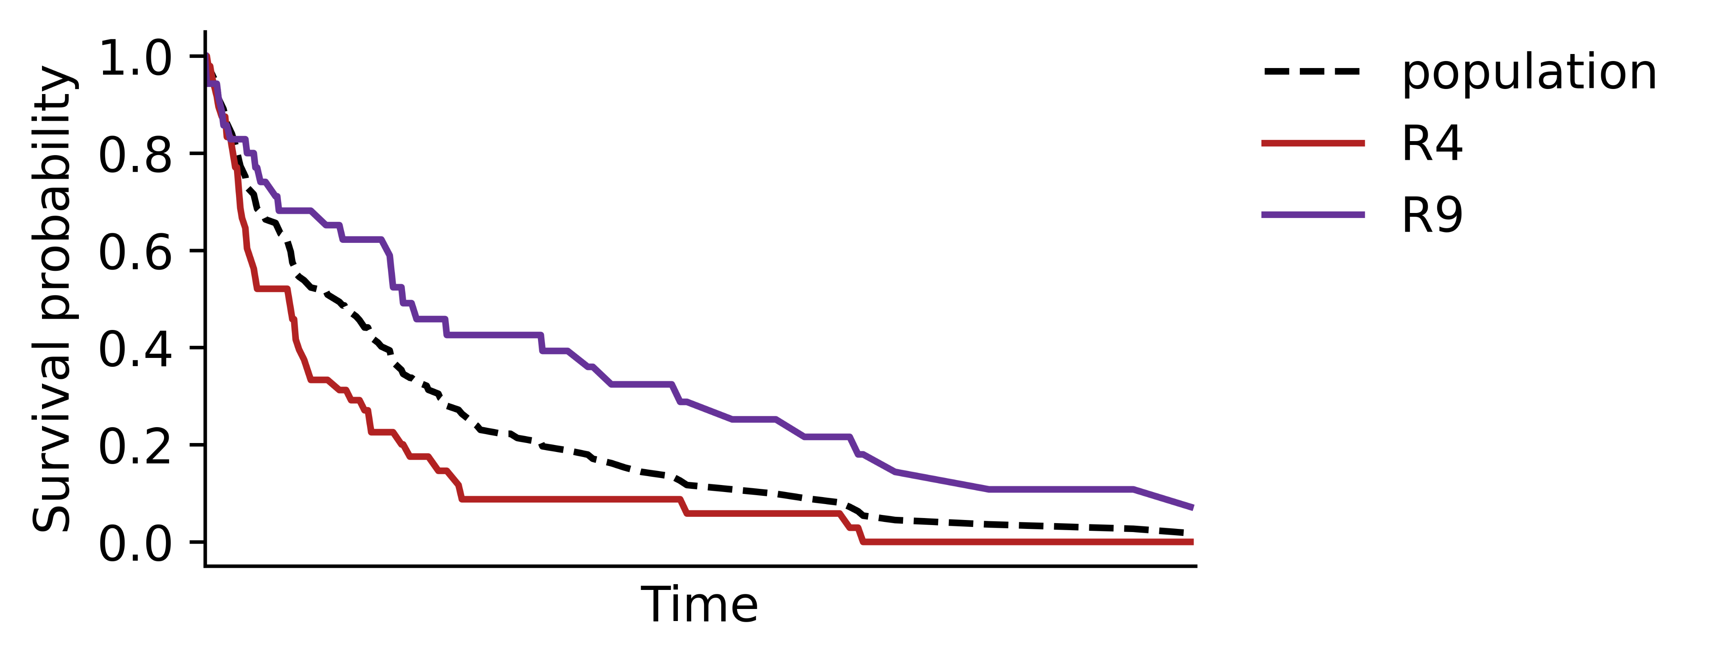
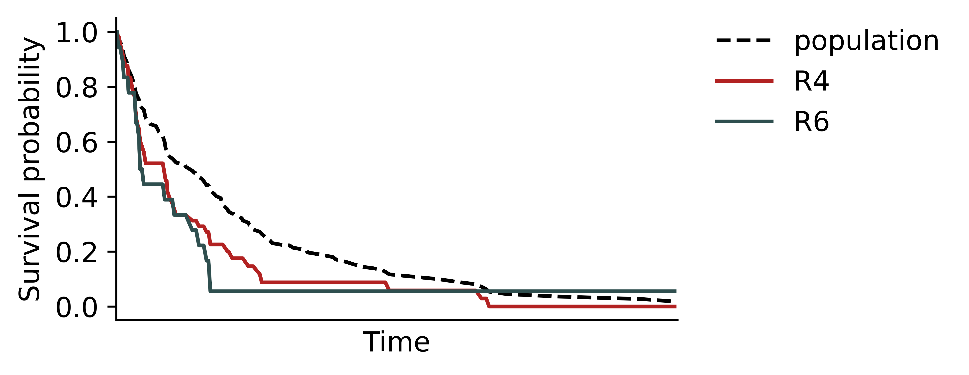
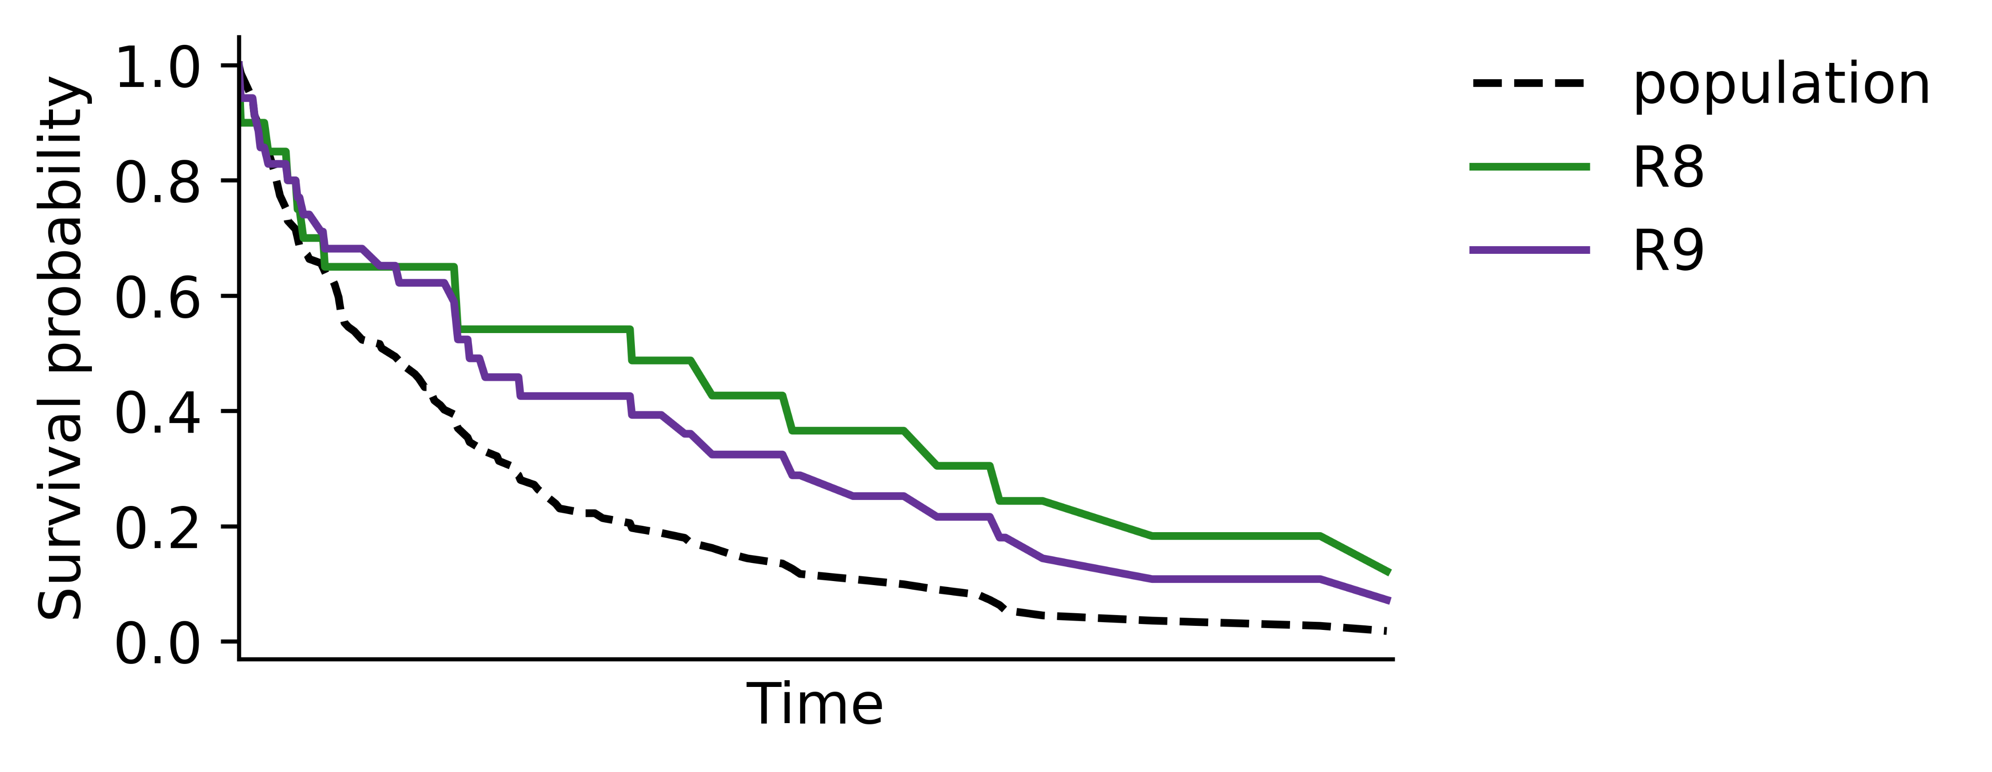
ESM-AM Results
Induced rules for veteran dataset
R4: IF cell-type = small THEN average survival = 71.67
R6: IF cell-type = small AND treat = test THEN average survival = 47.17
R8: IF cell-type = aquamous AND treat = test THEN average survival = 260.30
R9: IF cell-type = aquamous THEN average survival = 200.20
VETERAN DATA SET
Lung cancer
Notes:
At the same data set,
the algorithm also captured different treatment responses
for different cell types.
we observe that
the small type
when combined to the test treatment
suffered a decrease in survivability
While that for the aquamous type
we observe an improvement on the survival response
when submitted for the same treatment.

Slide 19
Future work
1
Cope with numerical attributes
4
Investigate new heuristic functions and
new pheromone updating procedure
2
Other quality measures: consider exceptionality and coverage
5
Expand the results’ analysis: further experimental statistical procedures and more detailed exploratory data analysis
3
Tackle problems: pattern’s redundancy, high-dimensionality and false statistical discoveries
Notes:
Finally, there are different directions to expand this study:
The adaptation of the algorithm to cope with numerical attributes;
To investigate other quality measures for the subgroups,
in other to consider not only its exceptionality
but also its coverage,
To tackle problems such as
pattern’s redundancy,
high-dimensionality
and false statistical discoveries;
To investigate new heuristic functions
and new pheromone updating procedures
for the AntColonyOptimization
to better capture survival relations on the induction process;
and expand the results’ analysis with further experimental statistical procedures
and more detailed exploratory data analysis.

Slide 20

Notes:
Thank you!

